Slide 1
Program Review Humanities Department
Integrated Planning & Budget Taskforce

Slide 2
Programs Strengths
Dynamic, highly qualified and dedicated part-time faculty
Innovative new course development
Interdisciplinary and investigative approach
Growth (360 % FTEF over the last five years)
Humanities Mellon Scholars Program
Humanities Department Lecture Series

Slide 3
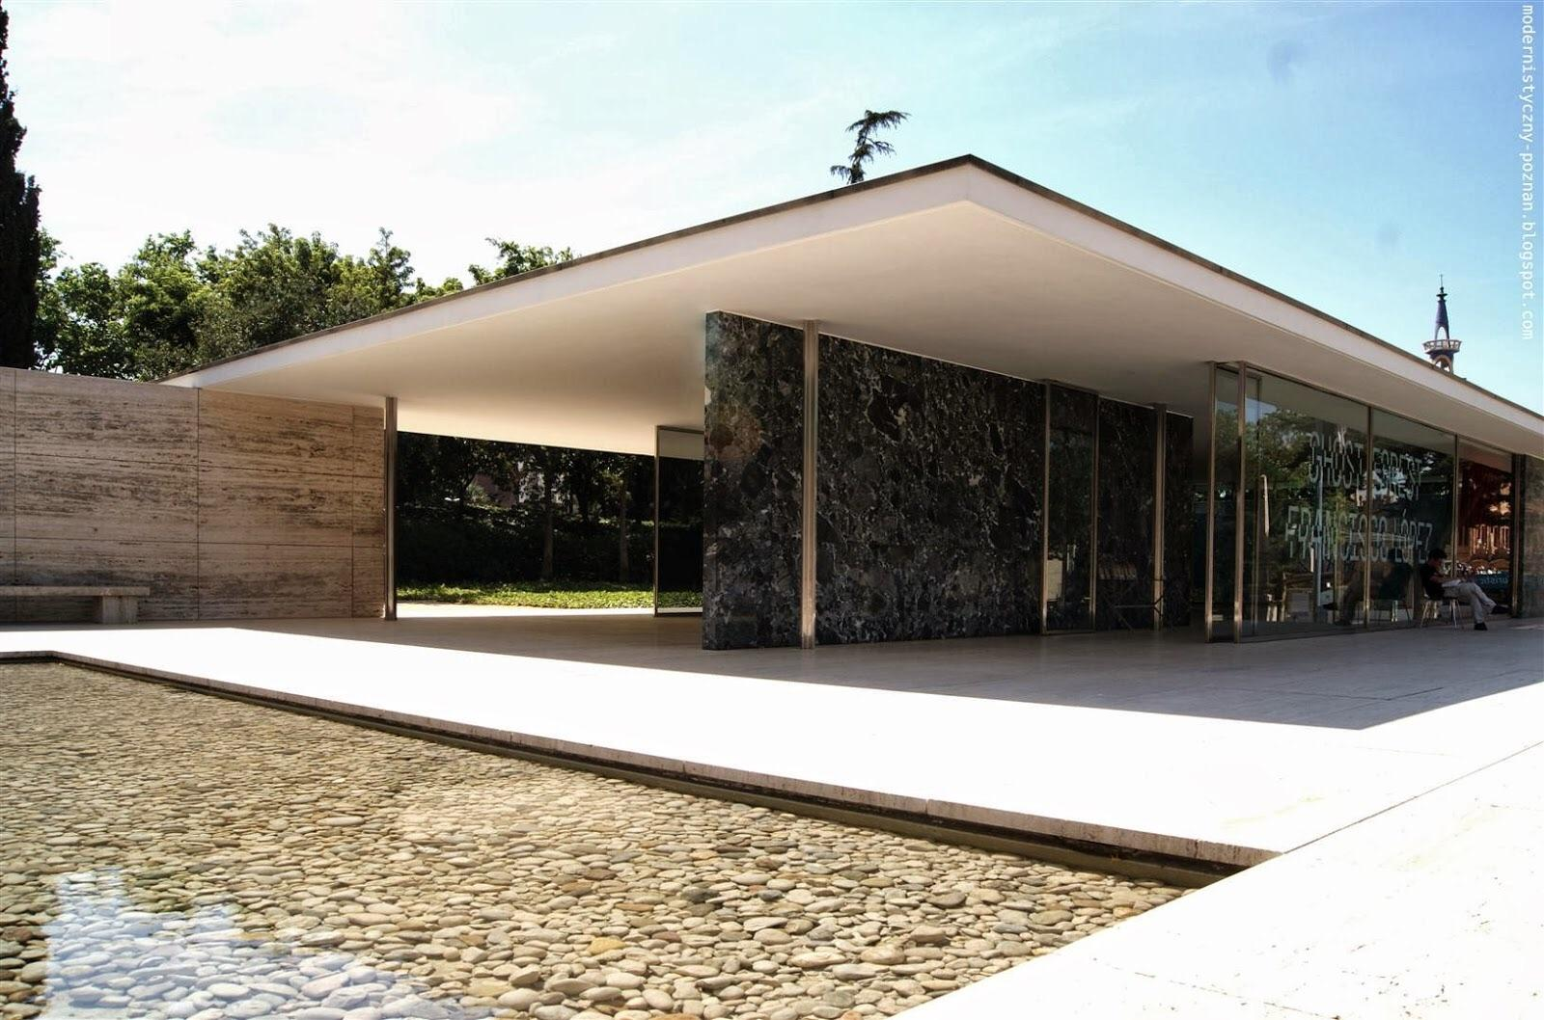
Programs’ Actions for Improvement
Less is More: reduce class seat count for Humanities courses from 50 to 35 with a reduction in load factor for 4 unit courses from .1 to .089 (same as De Anza’s HUMI courses)

Slide 4
Program Data
2018-2019 Course Success Rate
84% Overall Course Success Rate
74% African American, Latinx and Filipinx
89% Asian, Native American, Pacific Islander,
White, Decline to State

Slide 5
Resources Needed
Directions on how to make the seat count reduction
Ability to offer more Humanities sections
Additional Full-Time Faculty

Slide 6
Questions
In contrast to other institutions of higher learning, do community colleges place a greater emphasis on an education that serves economic growth?
How does education for economic growth intersect with education for democratic citizenship?

