Slide 1
Assessment for Placement: The Conversation Continues!
FHDA District Opening Day
September 21, 2017
Andrew LaManque, Associate Vice President of Instruction, Foothill College
Casie Wheat, Assessment Center Supervisor, De Anza College

Slide 2
What is Assessment?
Assessment is a holistic process through which each college collects information about students in an effort to facilitate their success by ensuring their appropriate placement into the curriculum. Examples of this information include the students’ English and math skills, study skills, learning skills, aptitudes, goals, educational background/performance, and the need for special services.
Reference: http://extranet.cccco.edu/Divisions/StudentServices/Matriculation/Assessment.aspx

Slide 3
Specific examples of community college assessment measures, or tools, include:
Placement Tests
High School Transcripts Data (courses taken, grades earned, GPA)
Early Assessment Placement (EAP) Exam Results
Advanced Placement (AP) Exam Results
Other Standardized Tests (CSU’s ELM, EPT; SATs; ACTs, TOEFL)
College Coursework
Background Questions (professional, military experience, etc.)
Non-Cognitive Information (grit, motivation, etc.)
Informed Self Placement
Counselor or Faculty Interview

Slide 4
Welcome!
Introductions
Warm Up Questions:
Do you know how we assess our students for placement into English, Reading, English as a Second Language (ESL), and Math courses?
Do you feel our students are being placed accurately?
Are there any specific questions that you would like answered today?

Slide 5
There will be a test at the end of this presentation.
Given current assessment research findings, state mandates and California Community College Chancellor’s Office (CCCCO) policy changes, how can Foothill- De Anza (FHDA) evolve to better assess our students?

Slide 6
Today’s Agenda
Research & Updates from the Field
FHDA Assessment for Placement
What do other college assessment models look like?
Half Time Break!
Placement Testing
Common Assessment Adoption Schedule
FHDA District Retest Policy – October 9, 2017
Multiple Measures Assessment Project (MMAP) & Pilot Results
Early Assessment Program (EAP) at Foothill
Test!

Slide 7
Current State of Assessment
Nationally, approximately two-thirds of students attending community college are identified as underprepared for college-level academics and are assigned to pre-college remedial (also known as developmental) courses. Remediation rates are even higher among students of color.
Dadgar, M., Collins, L., Schaefer, K.“Placed for Success: How California Community Colleges can improve accuracy of placement in English and math courses, reduce remediation rates, and improve student success.” Career Ladders Project, 2015. http://www.careerladdersproject.org/wp-content/uploads/2015/03/CLP_IP_Brief_37_508.pdf . Accessed 8 September 2017.

Slide 8
Research Findings
Research shows that a single standardized assessment tool does not accurately assess a community college student’s mastery of a subject (Willet & Karandjeff, 2014).
A study on standardized tests and their predictive value for student success in college level courses found that ONE in every THREE students were misplaced in English and ONE in every FOUR were misplaced in Math (Scott-Clayton & Belfield, 2012).
Willett, T. & Karandjeff, K. (2014). Stepping Up: Progression in English and math from high school to college. Sacramento, CA: The Research and Planning Group for California Community Colleges.
Scott-Clayton, J., & Rodriguez, O. (2012). Develop­ment, Discouragement, or Diversion? New evidence on the effects of college remediation (NBER Working Paper No. 18328). Cambridge, MA: National Bureau of Economic Research.

Slide 9
Updates from the Field
Title V, Section 55522
AB 705 (Irwin) Seymour-Campbell Student Success Act of 2012: Matriculation: Assessment

Slide 10
Title V, Section 55522
Colleges must employ at least two evidence-based measures in assessing a student. One of these measures may be an assessment test.
The measures chosen must be of different formats to allow students multiple opportunities to illustrate their knowledge and readiness. If another test is selected as a multiple measure, it may not be correlated with the first test.
CCCCO Memo: Clarification on—Multiple Measures Used in Student Assessment (9/30/16)

Slide 11
AB 705 (Irwin) Seymour-Campbell Student Success Act of 2012: Matriculation: Assessment PASSED!
AB 705 requires community college districts to maximize the probability that a student will enter and complete transfer-level coursework in math and English within a one-year timeframe through the use of multiple measures to achieve this goal.
The bill requires community colleges to use high school performance information when determining a students’ readiness for college-level English and math.
It also prohibits community colleges from requiring students to enroll in remedial coursework unless research proves that the students are highly unlikely to succeed in college-level coursework.

Slide 12
Has California Found the Answer to More Equitable Developmental Education?
From an equity standpoint this bill [AB 705] benefits students of color, as research indicates they do not perform as well on standardized tests, which do not consider students’ test-taking ability, stress levels, or social conditions at the time of the exams. The strong consideration of grades is also important, as extensive research has shown them as more effective indicators of overall student success in college. Similarly, an evaluation of a student’s high school profile, including both their academic and extracurricular accomplishments, is a more accurate predictor of potential and subsequent success in Math and English rather than exam scores alone.
Preston, Deshawn. “Has California Found the Answer to More Equitable Developmental Education?” Diverse Education. 26 July 2017. http://diverseeducation.com/article/99513/ Accessed 8 September 2017.

Slide 13
FHDA Assessment Model
 | Foothill | De Anza
English | Accuplacer (Test) High School Transcript Assessment EAP Result | Accuplacer & Local Essay (Test)
ESL | Accuplacer & Essay (Test) | CELSA & Local Essay (Test)
Math | Accuplacer (Test) High School Transcript Assessment EAP Result | Accuplacer & Local Calculus Readiness Exam (Test) High School Transcript Assessment

Slide 14
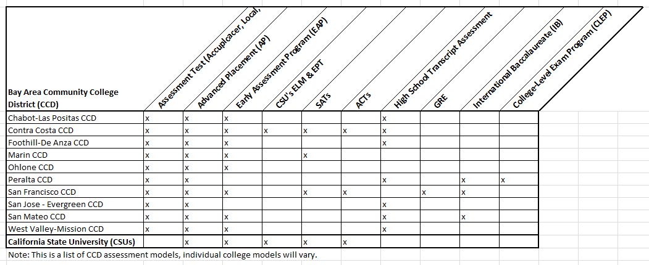
Assessment Models from Other Colleges

Slide 15
Impact of Placement on Student Life
Review the next few student profiles and discuss with your neighbor(s) about how the placement result impacted the student’s life.

Slide 16
Student Profile 1 Self-Reported Ethnicity: Vietnamese Student is a Member of College Special Population (Athlete, DSPS, Veteran, etc.): No
AY 2015-16 | AY 2016-17 | AY 2017-18
Enrollment Status: Part-Time Educational Goal: Undecided Major: Allied Health Placement Test Results: Math only Other Coursework/Grades: Basic Skills Math with passing grades GE and/or Elective courses with passing grades | Enrollment Status: Full-Time Educational Goal: Transfer to 4-Year Major: Business Admin for Transfer; then changed to Humanities Placement Test Results: English; MMAP Pilot eligible Accuplacer Placement Test Result: Two Levels Below (ENGL 209, 1A) High School Transcript Assessment Result: ENGL 1A English Grade Tracking: ENGL 1A - Fall 2016 - Grade: B ENGL 1B - Winter 2017 - Grade: B Other Coursework/Grades: College Level Math with passing grades GE and/or Elective courses with passing grades | Enrollment Status: Full-Time

Slide 17
Student Profile 2 Self-Reported Ethnicity: Mexican Student is a Member of College Special Population (Athlete, DSPS, Veteran, etc.): Yes
AY 2015-16 | AY 2016-17 | AY 2017-18
Enrollment Status: Full-Time Educational Goal: Obtain AA Major: Art; then changed to Business Administration; then changed back to Art Placement Test Results: English; MMAP Pilot eligible / Math: Basic Skills Accuplacer Placement Test Result: Three Levels Below (ENGL 209, 110, 1A) High School Transcript Assessment Result: Three Levels Below (ENGL 209, 110, 1A) English Grade Tracking: ENGL 209 - Fall 2016 - Grade: W Other Coursework/Grades Math 220 - Fall 2016 - Grade: W PE Activity Course - Fall 2016 - Grades: A | No Enrollment | No Enrollment

Slide 18
Student Profile 3 Self-Reported Ethnicity: Pacific Islander Student is a Member of College Special Population (Athlete, DSPS, Veteran, etc.): Yes
AY 2016-17 | AY 2017-18
Enrollment Status: Full-Time Educational Goal: Obtain AA; then changed to Transfer to 4-Year Major: Communications; then change to Communication Studies for Transfer Placement Test Results: English; MMAP Pilot eligible / Math: Basic Skills Accuplacer Placement Test Result: Three Levels Below (ENGL 209,110, 1A) High School Transcript Assessment Result: ENGL 1A English Grade Tracking: ENGL 1A - Fall 2016 - Grade: A ENGL 1B - Winter 2017 - Grade: B Other Coursework/Grades: Basic Skills Math with passing grades GE and/or Elective course with passing grades | Enrollment Status: Full-Time

Slide 19
Half Time Break
Any thoughts, comments, questions?
Here is what we will tackle next…
Placement Testing
Common Assessment Adoption Schedule
FHDA District Retest Policy – October 9, 2017
Multiple Measures Assessment Project (MMAP) & Pilot Results
Early Assessment Program (EAP) at Foothill
Q&A

Slide 20
Placement Testing: Common Assessment Initiative (CAI)
Common Assessment = The California Community College Placement Test
The CAI platform will display student common assessment results to all colleges where the student has applied
SB 1456 requires that colleges choosing to use a placement test must use the Common Assessment or lose SSSP funding
De Anza is a CAI pilot college
Anticipated FHDA Adoption Date:
De Anza - Fall 2018
Foothill – Spring 2019

Slide 21
CAI Competency Maps
The common assessment will have competencies, not cut scores, which will be used to place students into courses.
Competency maps will be assessed for validity and reviewed for disproportionate impact on student groups, if any.
When Foothill and De Anza adopt the common assessment, how will department competency maps impact student placement? Enrollment at your campus? Enrollment for our district?

Slide 22
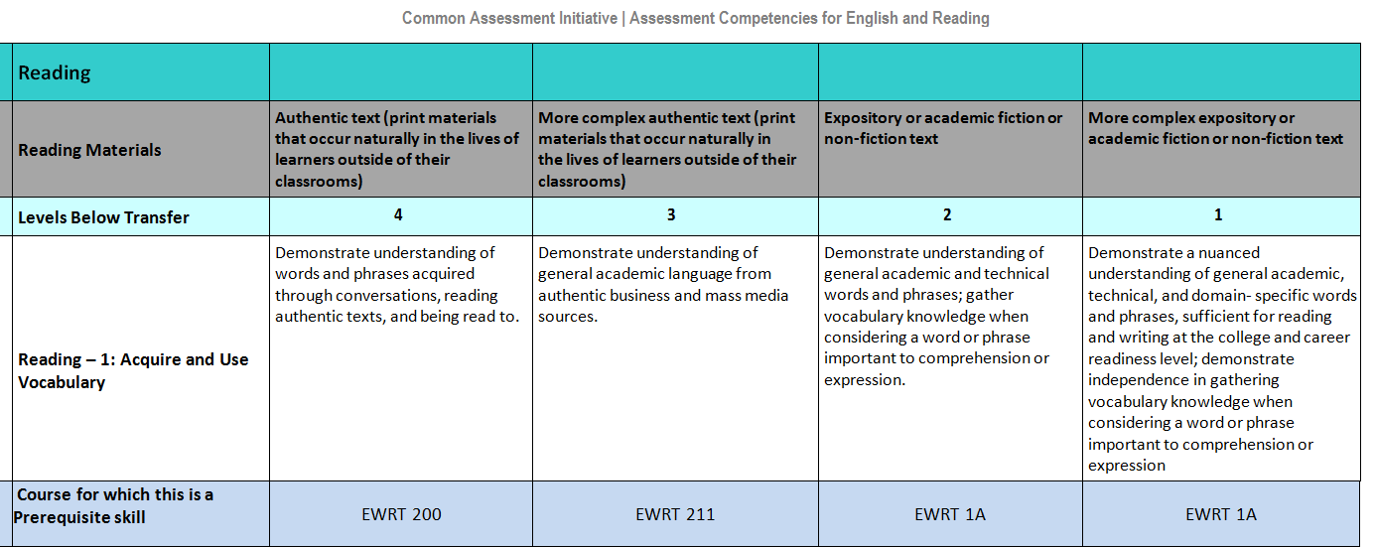
Foothill – Math Competency Map Example
De Anza – EWRT Competency Map Example

Slide 23
Placement Testing: District Retest Policy
On October 9, 2017,
Foothill and De Anza will adopt a new retest policy.
This will impact our students testing for Winter Quarter placement.

Slide 24
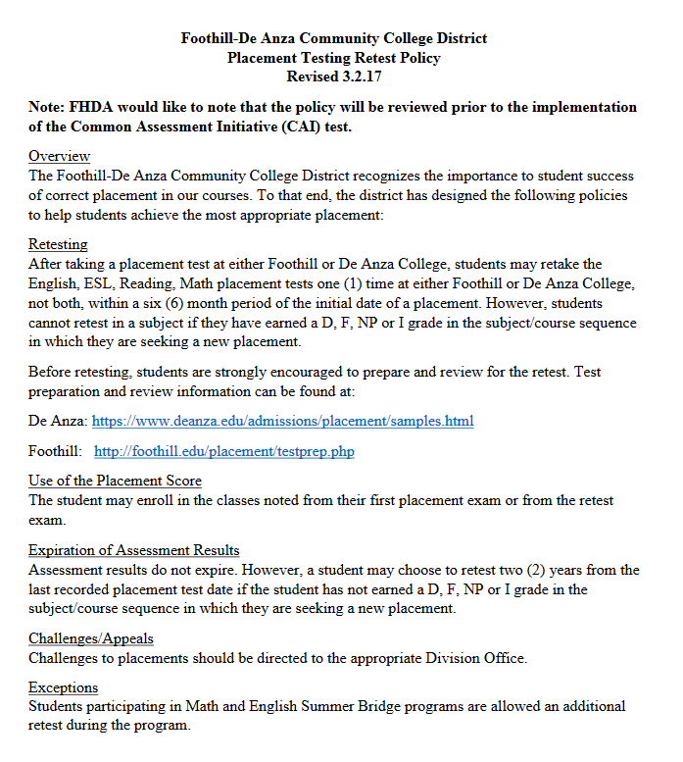

Slide 25
Multiple Measures Assessment Project (MMAP)
Research shows that placement tests under-place our students, especially our underrepresented populations
Using California high school and community college data, the Educational Results Partnership and the Research and Planning (RP) Group have developed decision models with:
High school GPA,
High school courses taken, and
Grades earned.
Decisions models maintain a 70% likelihood of student success in the course

Slide 26
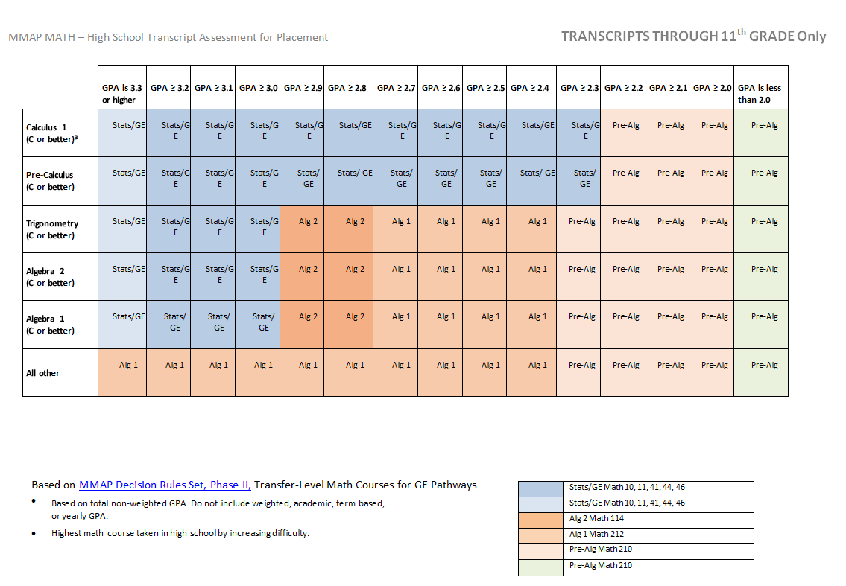
MMAP Math Pilot Decision Rules @ FH & DA
Foothill
MMAP Math Pilot
Placing students in Math 105 & Math 10 only.
De Anza
MMAP Math Pilot
Placing students up to Math 10, 11, 44, 46, 41.

Slide 27
Foothill MMAP Math Pilot Results Fall 2016

Slide 28
De Anza MMAP Math Pilot Preliminary Results
33% of students (1,280 students out of 3,884) who took a Accuplacer (ACCU) math placement test received a high school transcript assessment (HST) placement.
Of those that were assessed:
35% of student's HST placement were higher than ACCU results
38% of student's ACCU results were the same as the HST placement
24% of student's HST placement were lower than ACCU results

Slide 29
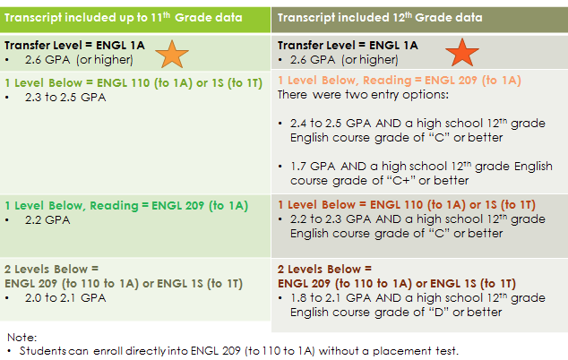
Foothill’s MMAP English Pilot Decision Rules

Slide 30
Foothill MMAP English Pilot Preliminary Results
The results in fall 2017 are consistent with the data from 2016 – roughly 40% of students are placed higher using high school GPA and course grade, along with the test result.

Slide 31
Early Assessment Program (EAP)
All California 11th Grade students take the California Assessment of Student Performance and Progress (CAASPP):
English Language Arts/Literacy Assessment
Mathematics Assessment
Note: Also known as Smarter Balanced Summative Assessment
K12 has partnered with the California State University (CSU) system to determine placement into college courses using CAASPP results. This is known as the Early Assessment Program (EAP). Now, some community colleges are adopting EAP results.

Slide 32
EAP Results for CSU Placement
Standard Exceeded = CSU College Level Ready
Exempt from CSU placement tests
Conditionally Ready = CSU Standard Met
Conditionally ready for college level coursework (pending 12th grade coursework)
Possibly exempt from CSU placement tests
Not Yet Ready = CSU Standard Nearly Met
Need additional preparation in 12th Grade
Required to take CSU placement tests
Not Ready = CSU Standard Not Met
Needs to demonstrate substantial improvement to be successful in college level course work
Required to take CSU placement tests

Slide 33
Foothill’s EAP Policy
Foothill accepts a result of “Standard Exceeded” to indicate that a student has demonstrated the level of skills acquired through three years of rigorous college preparatory coursework in the subject, math or English.
Can we consider other EAP results for placement at FHDA?
EAP Test | EAP Result | Course Placement
Math | Standard Exceeded | Math 10, 11, 44, 48A
English | Standard Exceeded | English 1A

Slide 34
De Anza’s EAP Policy
We are currently not accepting the EAP for placement; however, conversations are ongoing…

Slide 35
FHDA Assessment for Placement & ESL Course Sequences
What additional assessment tools, alongside the placement test, can we use to place our English second language learners into ESL classes?
Examples of assessment tools for ESL include, but are not limited to: English proficiency exams (TOEFEL, iTEP), IB course credit, SAT results, and faculty assessment/interview.
Keep in mind that both Foothill and De Anza have robust ESL populations, which include our full-time International Student Programs (ISP) students.

Slide 36
Final Thoughts?
Given current assessment research findings, state mandates and California Community College Chancellor’s Office (CCCCO) policy changes, how can Foothill- De Anza (FHDA) evolve to better assess our students?

Slide 37
Contact Information
Andrew LaManque
lamanqueandrew@fhda.edu
650-949-7179
Casie Wheat
wheatcasie@fhda.edu
408-864-8642

