Slide 1
The CAI & MMAP are coming to FHDA!
An Overview of the Common Assessment Initiative (CAI) & the Multiple Measures Assessment Project (MMAP)
FHDA District Opening Day / September 22, 2016 / De Anza, MLC 110
Stephen Fletcher
Andrew LaManque
Casie Wheat

Slide 2
First, a few fun facts:
The Common Assessment Initiative (CAI) is…
The Multiple Measures Assessment Project
(MMAP) is…
A statewide initiative that will develop and launch the CCCAssess tool, or new assessment platform, for California community college student placement into course sequences
Required for FHDA to adopt or risk losing Student Success and Support Program (3SP) funding
A collaborative project led by the RP Group and Educational Results Partnerships’ Cal-PASS Plus system, with support from the California Community College Chancellor’s Office (CCCCO)
Developing, piloting, and assessing the implementation of a statewide placement tool using multiple measures
An optional practice for colleges to adopt when seeking additional assessment tools

Slide 3
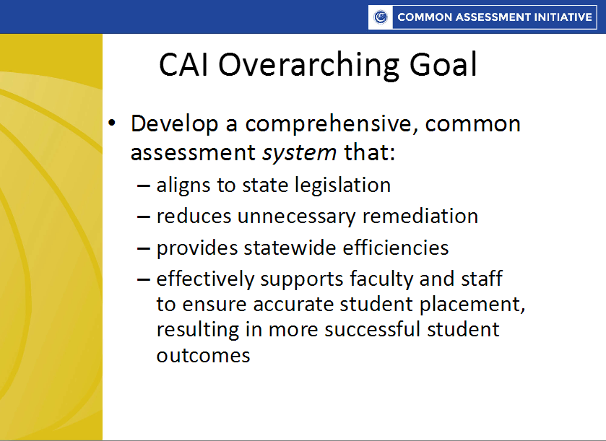
Common Assessment Initiative (CAI) Platform
Students will be able to transition seamlessly between California Community Colleges
http://cccassess.org/documents/all-documents/professional-development/documents-and-resources

Slide 4
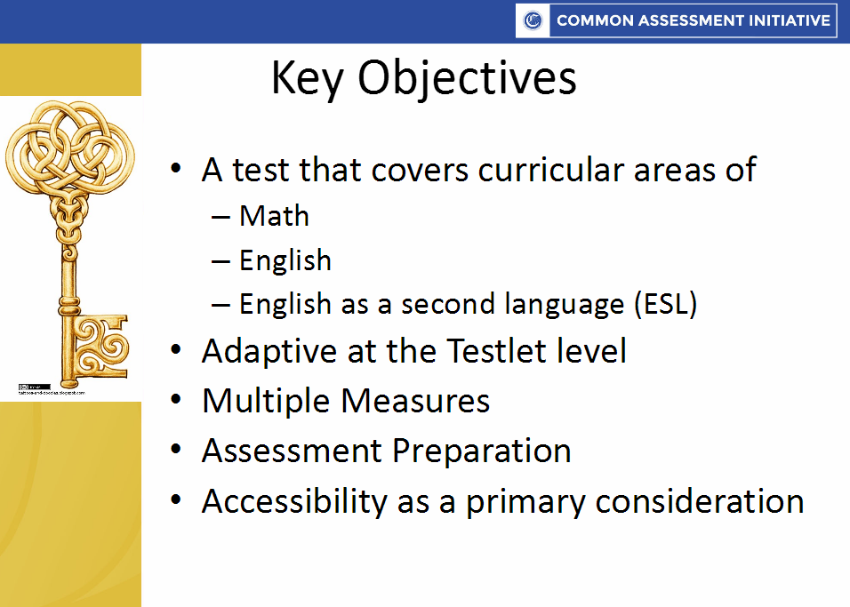
CAI Key Objectives
- Reading
http://cccassess.org/documents/all-documents/professional-development/documents-and-resources

Slide 5
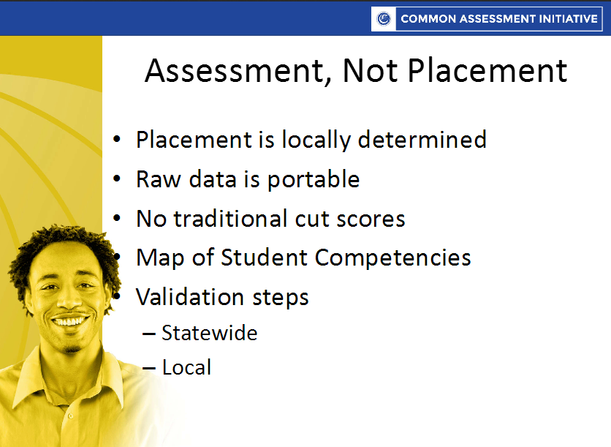
Common Assessment at FHDA
http://cccassess.org/documents/all-documents/professional-development/documents-and-resources

Slide 6
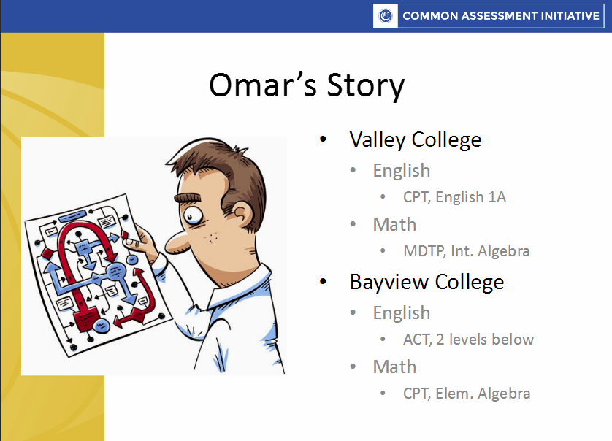
Student Experience
http://cccassess.org/documents/all-documents/professional-development/documents-and-resources

Slide 7

Common Assessment Introduction & Overview Video
https://youtu.be/gcDShO4As0o

Slide 8
It takes the entire FHDA village!
Instructional Faculty
Competency mapping; determine local placement model
Admissions & Records / Counseling
Clearance and delivery of placement for registration
ETS
CAI-Banner integration
Institutional Research
Verify score uploads; placement validation
Administration
Enrollment processes; professional development
Assessment Center
Enter competency mapping; pilot and transition to CCCAssess platform; CCCAssess student outreach
http://cccassess.org/documents/all-documents/implementation-resources/16-college-implementation-team-guide

Slide 9
FHDA’s Common Assessment Adoption Timeline
Summer 2016
ETS began work for CAI – Banner data integration
Fall Quarter 2016
ESL, English, Reading and Math faculty to engage in discipline-specific competency mapping at respective campuses
Assessment Centers build placement rules based on competency mapping
Winter Quarter 2017
FHDA to adopt CAI in February 2017 for Fall Quarter 2017 Placement

Slide 10
Common Assessment, Local Placement
Departments are beginning to plan for competency mapping
[Faculty in audience to share thoughts?]

Slide 11
Multiple Measures for Assessment Project (MMAP)
Title V requires assessment for placement using multiple measures
Purpose:
Streamline the basic skills-to-transfer level pathway
Place students into courses they can successfully complete in college without repeating courses that they successfully completed in high school
Following the MMAP recommended practices, FHDA piloted the use of high school transcript data for placement alongside the Accuplacer placement test in 2015-16

Slide 12
MMAP Pilots @ FHDA
De Anza
Foothill
Placement into the Math Course Sequence
Design:
Winter testers for Spring 2016 placement
CalPass+ provided transcripts for placement
Next Steps:
Review results with departments
Launch of Math Pilot for Fall 2016
Placement into Math 10 & English Course Sequence
Design:
Spring & Summer testers for Fall 2016 placement
Self-reported high school GPA, courses taken, grades earned
10% of pilot population audited for high school transcript submission and evaluation
Next Steps:
Review preliminary results with departments
Analysis of student success rates when Fall grades are posted

Slide 13
Contextualizing the CAI & MMAP within the FHDA community
Goodbye Accuplacer, Hello Common Assessment!
Retirement of cut scores and the development of competency maps
Will have access to high school transcript data for placement in course sequences, should your campus choose to adopt high school transcript data as a tool for placement

Slide 14
FHDA District Assessment Taskforce
Membership—Join us!
FH Interim Vice President of Instruction Andrew LaManque
DA Academic Senate President Randy Bryant
FH Academic Senate President Carolyn Holcroft
DA Assessment Center Supervisor Stephen Fletcher
FH Acting Assessment Center Supervisor Casie Wheat
Goals:
Explore common retest and recency policies
CAI planning and adoption oversight
Next CAI Professional Development Meeting:
November/December 2016 @ Bay Area

Slide 15
Questions?

